Slide 1
Rendezvous
Movie Meetup.

Slide 2
Attendee Perspective

Slide 3
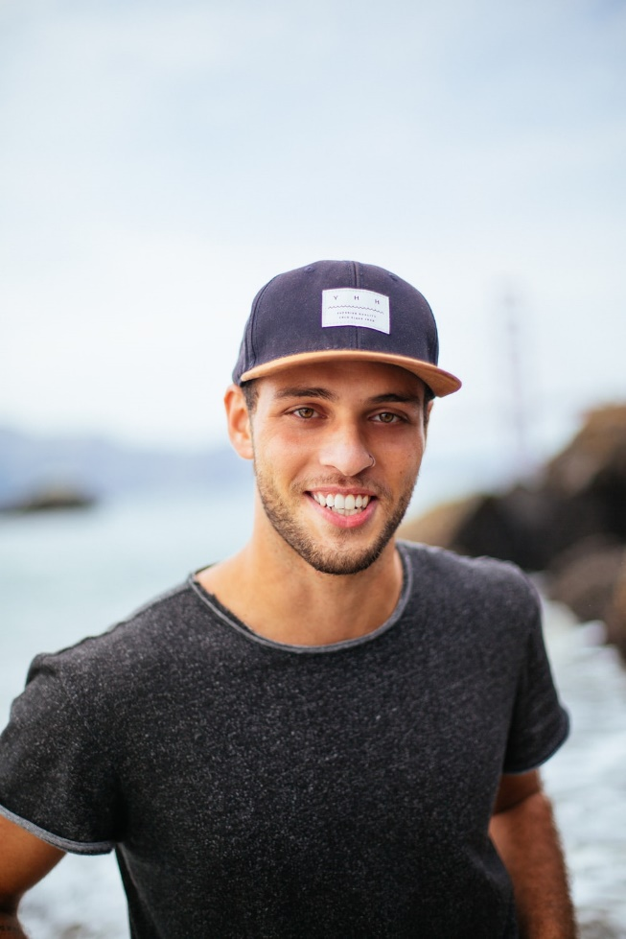
Attendee Profile
Name: Jon Smith
Age: 26
Occupation: Student
Location: Feltham, London

Slide 4
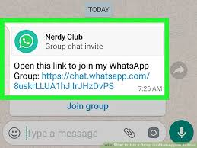
1.
Received
invitation
for joining
a group

Slide 5
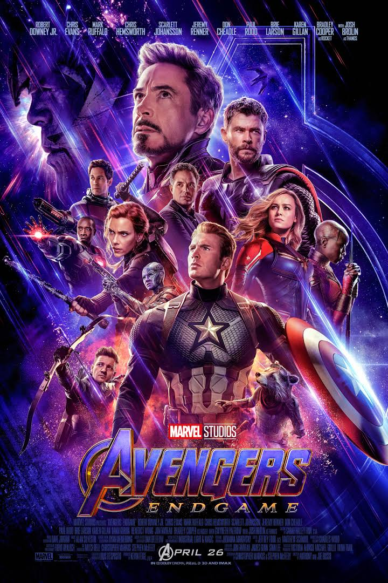
2.
Received
movie meetup
request from
the organizer

Slide 6
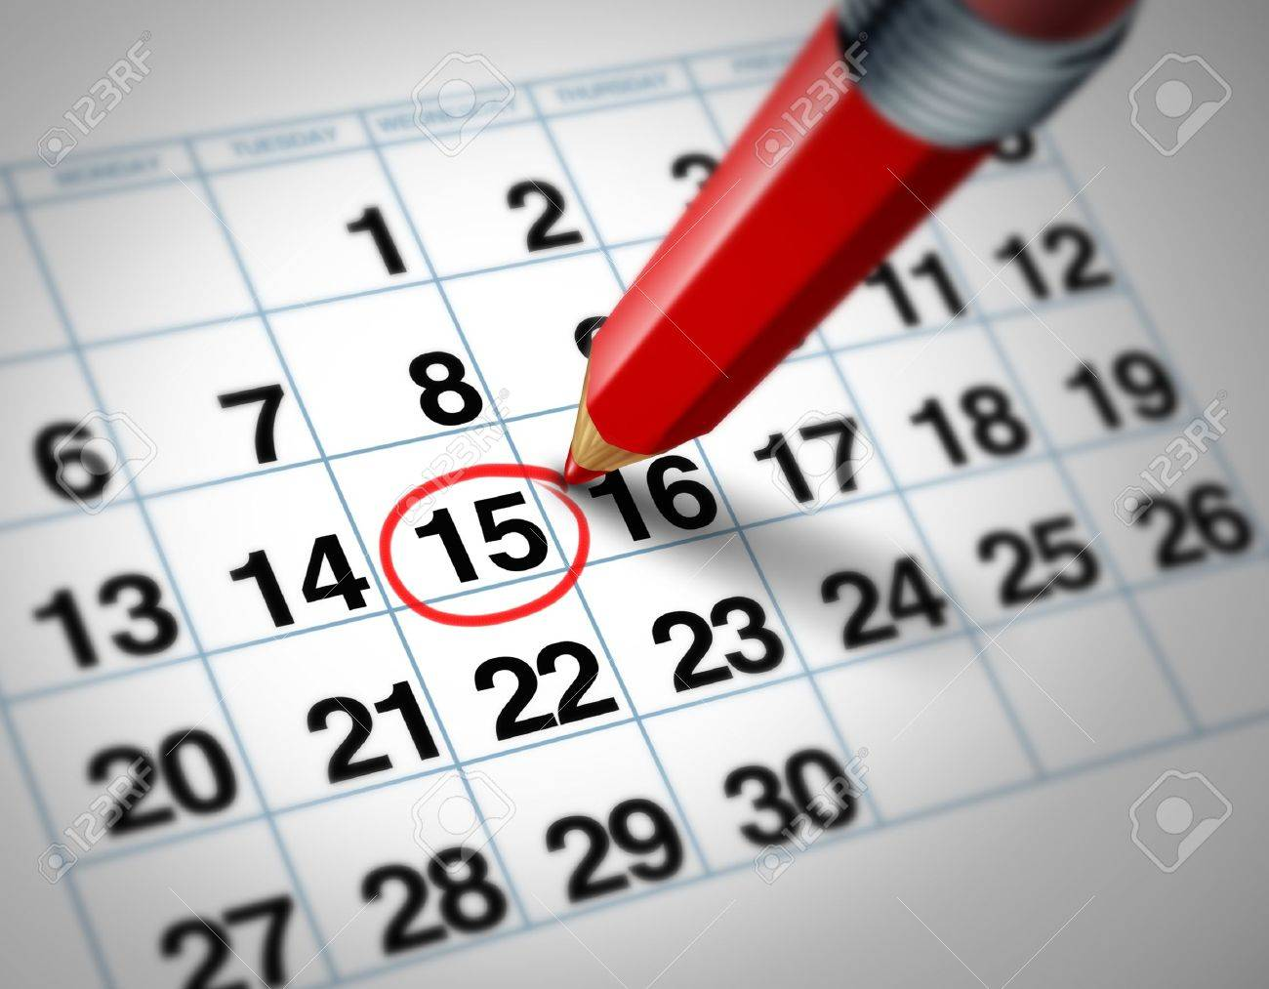
3.
Received
meetup details:
location, timing,
date, number
of attendee,
lunch preferences

Slide 7

4.
Checked
movie trailer
and reviews
online

Slide 8
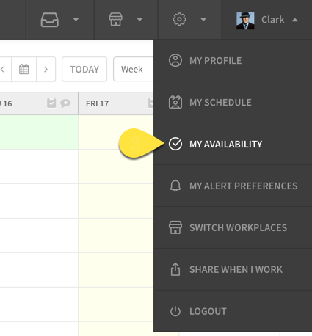
5.
Checked
my availability
for day

Slide 9

6.
Made
decision:
Going

Slide 10
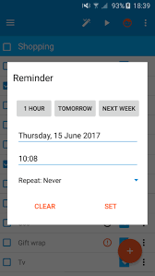
7.
Set reminder
for the
event

Slide 11
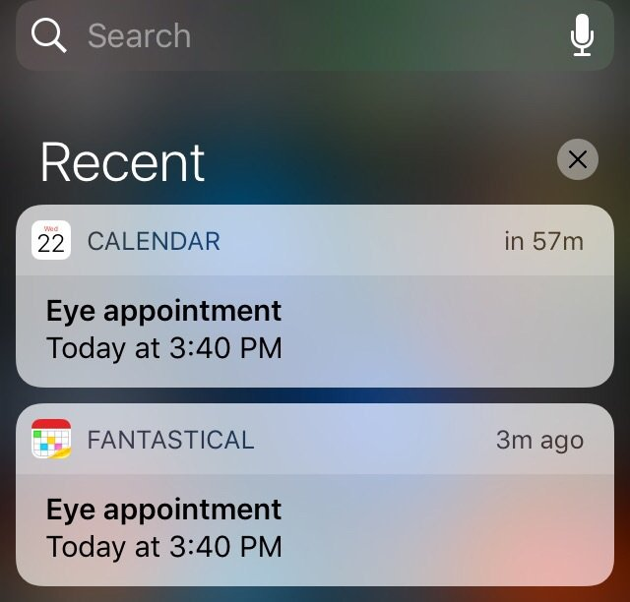
8.
Received reminder
from organiser
day before
the meetup

Slide 12
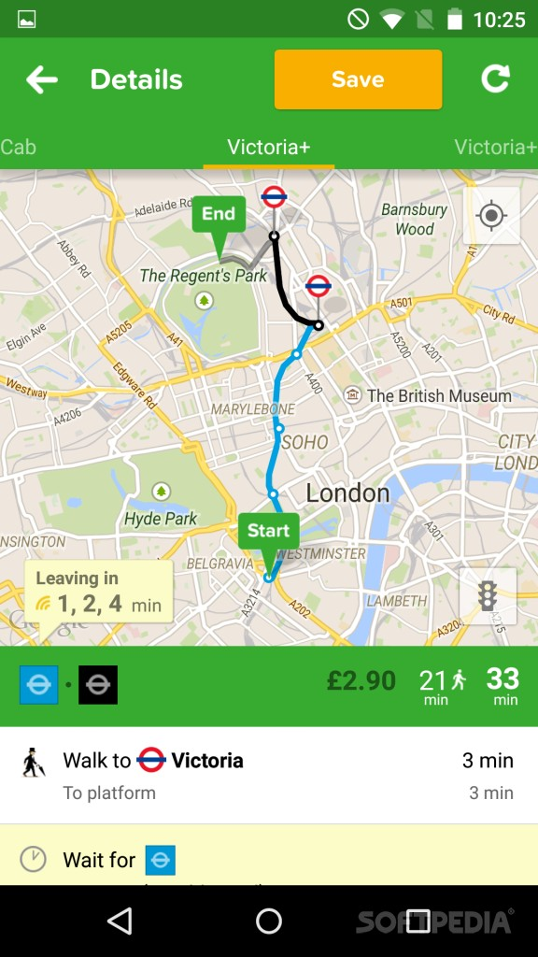
9.
On meetup day:
Checked city mapper
for timings, fare and
mode of transport to use

Slide 13
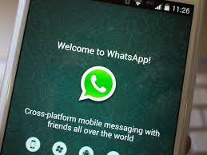
10.
Informed everyone
before leaving
and used bus
for reaching
to the venue

Slide 14
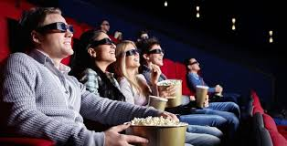
11.
Met everyone
at the movie
theatre and
watched movie

Slide 15
Empathy Map:
Organiser

Slide 16
SAYS
Lets go for movie
night
Asked everyone’s
preferences
Which movie, location
to select?
Who should I invite?

Slide 17
DOES
Sent group invitation
link
Created group
Booked tickets
Planned meetup
Asked food
preferences
Sent reminder

Slide 18
THINKS
Which movie to select?
Which location?
Who to invite?
No. of attendee?
Time?
Date?
Dispose event?
Ticket booking
mode?
Mode of payment?

Slide 19
FEELS
Excited
Anxious
Feeling stressed
out
Anxious

